Slide 1

BD9B300MUV-E2EVK-101 Measurement Report
August 11, 2014
Hosted by: Xuan Dang & Vu Phan

Slide 2
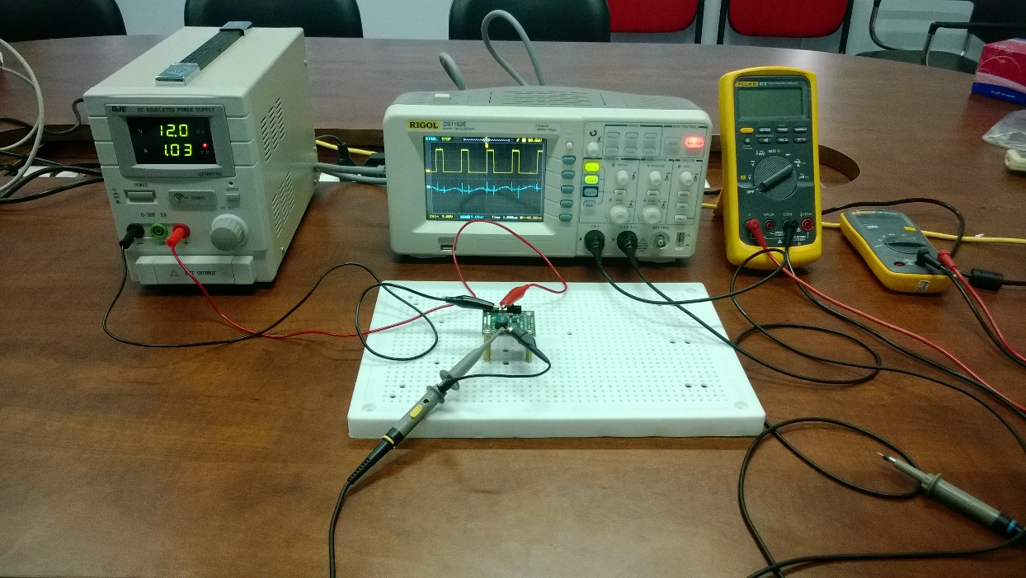
Equipment list
Regulated DC Power Supply
QJE QJ3005XE (0-30V/5A)
Multimeter:
Fluke 87V True RMS
Fluke 106
Oscilloscope
Rigol DS1102E
Electronic Load
B&K BK8500
Current probe
RP1001C

Slide 3
Functional Test
Testing procedure
Turn on the DC Supply. Set output of the DC Supply in range from 2.7V to 5.5V and turn it off. Connect DC the Supply to: [+]V_{IN}(TP2) and [-]GND(TP3) of evaluation board.
Connect Electronic Load to: [+]V_{OUT}(TP4) and [-]GND(TP5). Power on Electronic Load, set input of Electronic Load to 3A.
Set constant on-time and operation mode of device.
Turn on the DC Supply.
Turn on load.
Move header J1 to turn EN on.

Slide 4
Functional Test (cont.)
Result:
V_{IN} = 5V
I_{OUT} = 3A
FREQ (Set by header J2) | MODE (Set by header J3) | V_{OUT} | Result
2.0MHz (FREQ=L) | DSLLM/PWM (MODE=L) | 3.32V | Passed
2.0MHz (FREQ=L) | PWM (MODE=H) | 3.31V | Passed
1.0MHz (FREQ=H) | DSLLM/PWM (MODE=L) | 3.31V | Passed
1.0MHz (FREQ=H) | PWM (MODE=H) | 3.31V | Passed

Slide 5
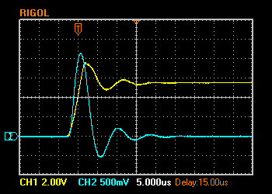
Hot Plugging Test
Test condition
V_{IN} = 5.5V
I_{OUT} = 3A
With original diode D1: P4SMA6.8A
Result:
I_{IN_MAX}= 21.4A
V_{IN} peak transient voltage is 7.6V > V_{IN} Maximum Rating (7V)
The IC still operate properly after 100+ test time.
V_{IN} 2V/Div. (DC)
I_{IN} 5A/Div. (AC)

Slide 6
Circuit Quiescent Current Measurement
Test condition
V_{IN} = 0-5.5V
Room temperature 25ºC

Slide 7
Efficiency Measurements
Test condition
V_{IN} = 5V
V_{OUT} = 3.3V
With P4SMA6.8A
Room temperature 25ºC

Slide 8
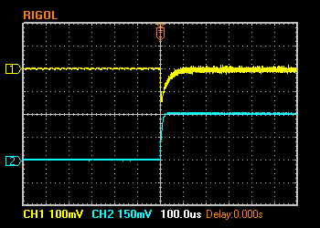
Load Response Measurements
Load response characteristic
(V_{IN}=5V, V_{OUT}=3.3V, I_{OUT}=0 → 3A, FREQ=L, MODE=L)
V_{OUT} 100mV/Div. (AC)
I_{OUT} 1.5A/Div. (DC)

Slide 9
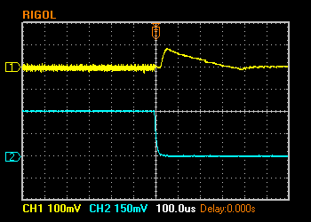
Load Response Measurements (cont.)
Load response characteristic
(V_{IN}=5V, V_{OUT}=3.3V, I_{OUT}=3A → 0, FREQ=L, MODE=L)
V_{OUT} 100mV/Div. (AC)
I_{OUT} 1.5A/Div. (DC)

Slide 10
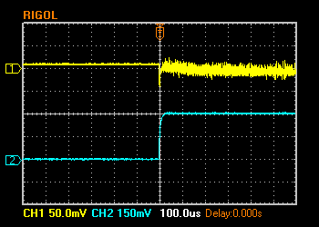
Load Response Measurements (cont.)
Load response characteristic
(V_{IN}=5V, V_{OUT}=3.3V, I_{OUT}=0 → 3A, FREQ=L, MODE=H)
V_{OUT} 50mV/Div. (AC)
I_{OUT} 1.5A/Div. (DC)

Slide 11
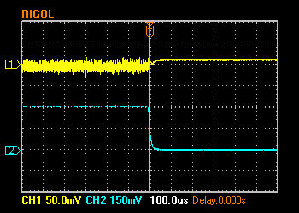
Load Response Measurements (cont.)
Load response characteristic
(V_{IN}=5V, V_{OUT}=3.3V, I_{OUT}=3A → 0, FREQ=L, MODE=H)
V_{OUT} 50mV/Div. (AC)
I_{OUT} 1.5A/Div. (DC)

Slide 12
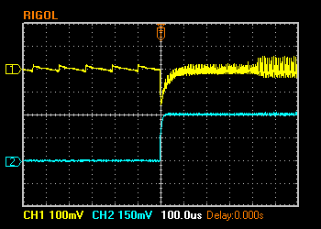
Load Response Measurements (cont.)
Load response characteristic
(V_{IN}=5V, V_{OUT}=3.3V, I_{OUT}=0 → 3A, FREQ=H, MODE=L)
V_{OUT} 100mV/Div. (AC)
I_{OUT} 1.5A/Div. (DC)

Slide 13
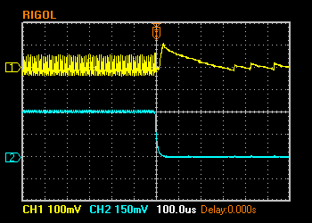
Load Response Measurements (cont.)
Load response characteristic
(V_{IN}=5V, V_{OUT}=3.3V, I_{OUT}=3A → 0, FREQ=H, MODE=L)
V_{OUT} 100mV/Div. (AC)
I_{OUT} 1.5A/Div. (DC)

Slide 14
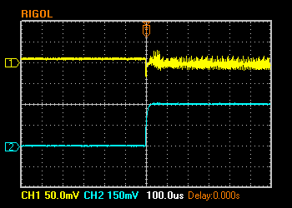
Load Response Measurements (cont.)
Load response characteristic
(V_{IN}=5V, V_{OUT}=3.3V, I_{OUT}=0 → 3A, FREQ=H, MODE=H)
V_{OUT} 50mV/Div. (AC)
I_{OUT} 1.5A/Div. (DC)

Slide 15
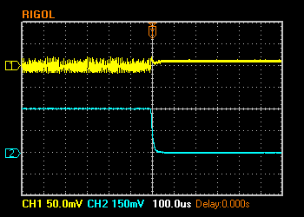
Load Response Measurements (cont.)
Load response characteristic
(V_{IN}=5V, V_{OUT}=3.3V, I_{OUT}=3A → 0, FREQ=H, MODE=H)
V_{OUT} 50mV/Div. (AC)
I_{OUT} 1.5A/Div. (DC)

Slide 16
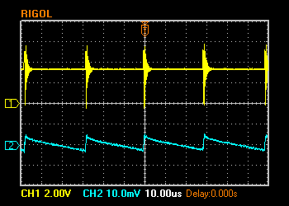
Ripple Response Measurements
V_{OUT} Ripple voltage
(V_{IN}=5V, V_{OUT}=3.3V, I_{OUT}=0, FREQ=L, MODE=L)
V_{SW} 2V/Div. (DC)
V_{OUT} 10mV/Div. (AC)

Slide 17
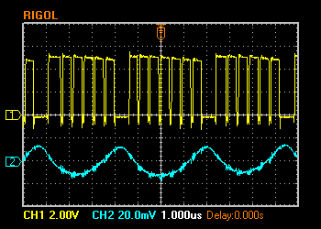
Ripple Response Measurements (cont.)
V_{OUT} Ripple voltage
(V_{IN}=5V, V_{OUT}=3.3V, I_{OUT}=3A, FREQ=L, MODE=L)
V_{SW} 2V/Div. (DC)
V_{OUT} 20mV/Div. (AC)

Slide 18
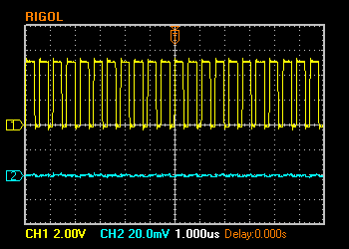
Ripple Response Measurements (cont.)
V_{OUT} Ripple voltage
(V_{IN}=5V, V_{OUT}=3.3V, I_{OUT}=0, FREQ=L, MODE=H)
V_{SW} 2V/Div. (DC)
V_{OUT} 20mV/Div. (AC)

Slide 19
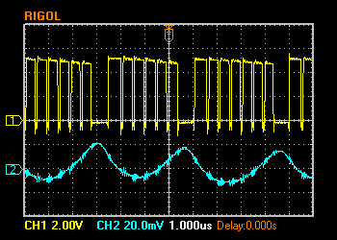
Ripple Response Measurements (cont.)
V_{OUT} Ripple voltage
(V_{IN}=5V, V_{OUT}=3.3V, I_{OUT}=3A, FREQ=L, MODE=H)
V_{SW} 2V/Div. (DC)
V_{OUT} 20mV/Div. (AC)

Slide 20
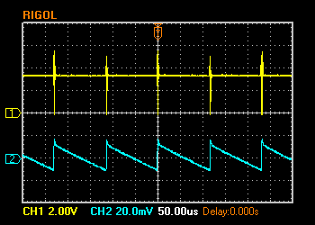
Ripple Response Measurements (cont.)
V_{OUT} Ripple voltage
(V_{IN}=5V, V_{OUT}=3.3V, I_{OUT}=0, FREQ=H, MODE=L)
V_{SW} 2V/Div. (DC)
V_{OUT} 20mV/Div. (AC)

Slide 21
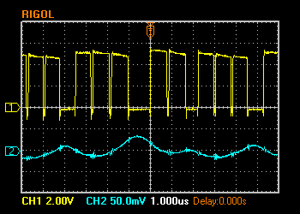
Ripple Response Measurements (cont.)
V_{OUT} Ripple voltage
(V_{IN}=5V, V_{OUT}=3.3V, I_{OUT}=3A, FREQ=H, MODE=L)
V_{SW} 2V/Div. (DC)
V_{OUT} 50mV/Div. (AC)

Slide 22
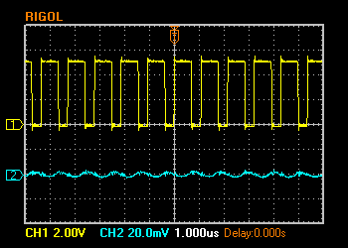
Ripple Response Measurements (cont.)
V_{OUT} Ripple voltage
(V_{IN}=5V, V_{OUT}=3.3V, I_{OUT}=0, FREQ=H, MODE=H)
V_{SW} 2V/Div. (DC)
V_{OUT} 20mV/Div. (AC)

Slide 23
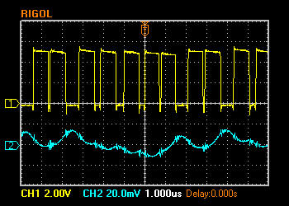
Ripple Response Measurements (cont.)
V_{OUT} Ripple voltage
(V_{IN}=5V, V_{OUT}=3.3V, I_{OUT}=3A, FREQ=H, MODE=H)
V_{SW} 2V/Div. (DC)
V_{OUT} 20mV/Div. (AC)

